Slide 1
Software Configuration Management
(SCM) Practitioner Training
Implementing
SCM
Notes:
Created SCM Prac V1.0 11.19.2001 by J. Reyna
Software Configuration Management is the discipline of identifying the components of a continually evolving system for the purposes of controlling changes to those components and maintaining integrity and traceability throughout the life cycle
Software Configuration Management is a formal engineering discipline which provides software developers and users with the methods and tools to identify the software developed, establish baselines, control changes to the baselines, record and track status, and audit the product
Lets look at the 2nd layer of our Software Quality Program.
Configuration Management is the process that tracks all the updates, additions, deletions and corrections to your SW and related documents.
You need this process to assure that you have the most current and best version of SW identified and packaged with up to date documentation.
Alternate verbiage: Ok, is everyone rejuvenated from the break? Configuration Management will be our last process for today, followed by an exercise to cement the concepts that we will be learning. I think CM is the most straightforward of all the quality processes. Everything you need to do is laid out. You just need to dedicate some resources and pick a diligent organized person to manage your CM.
It is an activity which you need to do properly.
(Note: HAS TWO HIDDEN SLIDES - At summary and NISBS cycle. (To print student viewgraphs, DEselect “Print Hidden Slides” box on print window.)

Slide 2
Objectives
Part 1: Overview of SCM (taught separately)
  Why SCM?
    Purpose
    Importance
  Overview of Major SCM Activities
    Identification
    Baselining and change control
    Status accounting
    Audits
  Resources at SSC-San Diego for implementing SCM
= = = = = = = = = = = = = = = = = = = = =
Part 2: Practitioners’ Training
Implementing SCM
    Applying the SCM Process
    Creating and Implementing SCM Plans and Procedures
Notes:
For this class--Identify current CM capabilities and challenges

Slide 3

Implementing SCM:
Applying the SCM Process
TASKS:
MANAGING SCM
IMPLEMENTING SCM
- Create and maintain project SCMP
- Manage implementation of SCMP
- Provide SCM training
- Perform configuration identification
- Perform configuration control
- Perform configuration status accounting (CSA)
- Perform configuration audits and reviews
Notes:
Draft A of Ver 2.0 of the CMM retains these words (well, they did get rid of the 2nd ‘project’)--they are a pretty good description of what a good SCM system can do for a project.

Slide 4
SCM Expert Mode (1 of 3)
PRX-SCM-01 v1.0 Software Configuration Management (Expert Mode) 10/30/01
Process: Software Configuration Management Phase: Global
(SCM)
Process Owner: SSC San Diego SEPO
Description: SCM establishes and maintains the integrity of the products of a software project throughout the software life cycle. SCM involves identifying the configuration of products that are delivered to the customer and used in development, systematically controlling changes to the configuration, and maintaining the integrity and traceability of the configuration.
Entry Criteria/Inputs:
Technical data: specifications, requirements,
designs, code, documentation
Programmatic data: project plans and schedules
(e.g., Software Development Plan); reports,
review results
Change requests (CRs)
Resources and training for the SCM process
Exit Criteria/Outputs:
SCM Plan (SCMP)
SCM Desktop Procedures (DTPs)
SCM review, and audit reports
Personnel trained in SCM
Products baselined and controlled
Notes:
In our overview of SCM that we present in our Software Project Management course, we highlight the “Expert Mode” for SCM, a kind of engineer’s gouge sheet that describes the basic elements of the SCM process here at SSC-SD.
(Describe briefly the elements of the expert mode, and describe how they summarize the elements of implementing SCM).

Slide 5
SCM Expert Mode (2 of 3)
Roles:
  Project Manager (PM): appoints and oversees SCM organization
  SCM Manager(SCMM), if appointed: leads SCM group
  SCM Group: team of individual SCM practitioners who implement this process
  Software Configuration Control Board (SCCB): evaluates and makes decisions that affect baselines
  Senior Management: periodically reviews SCM activities
  Software Quality Assurance (SQA): audits products and SCM activities
Assets/References:
  a. SSC San Diego SCM Policy, at http://sepo.spawar.navy.mil/ under SCM KPA
  b. (NAVAIR) SCM Process Definition, at http://sepo.spawar.navy.mil/ under SCM KPA
  c. (NAVAIR) Generic SCM Plan, at http://sepo.spawar.navy.mil/ under SCM KPA
  d. IEEE/EIA 12207.0, Software Life Cycle Processes, Clause 6.2: Configuration management process
  e. IEEE Standard 1042, IEEE Guide to Software Configuration Management
  f. Capability Maturity Model for Software (SW-CMM), SCM Key Process Area (KPA)
  g. MIL-STD-498: Software Development and Documentation (cancelled, but useful as guidance)
  h. MIL-STD-973: Configuration Management (cancelled, but useful as guidance)
Notes:
This expert mode includes a brief description of the players in SCM, and the resources they can draw upon to implement or maintain SCM on their project.

Slide 6
SCM Expert Mode (3 of 3)
Tasks: consist of Managing SCM (tasks 1-3) and Performing SCM (tasks 4-7)
1. Create and maintain project SCMP 4. Perform configuration identification
2. Manage implementation of SCMP 5. Perform configuration control
3. Provide SCM training 6. Perform configuration status accounting (CSA)
7. Perform configuration audits and reviews
Measures:
Effort and funds expended for SCM tasks
PROCESS TASKS …
  (details addressed in upcoming viewgraphs)
Notes:
But now, in this Practitioner’s training module, let’s focus on the tasks of the Expert Mode, the actual steps you must take to successfully implement SCM here at SSC-SD.

Slide 7

Create and Maintain the SCMP
1: Create SCMP
Purpose of the SCMP:
Ensure that all SCM activities are identified, assigned and planned
Define and document how SCM will be implemented
NOTE: If starting the project, ensure acceptance by the project team prior to the start of software development
Notes:
To begin with, you need to plan the activities your SCM will perform. Make certain all the participants have a hand in defining the planned SCM activities and reviewing and approving the documented plans and procedures you create.

Slide 8
The SCMP
1: Create SCMP
SCMP
To Create the SCMP:
Use Generic SCMP* (a Level 2 AND Level 3 requirement!) as the plan template and tailor specific to project requirements
  DO Tailor Roles and Responsibilities, Document/Report Formats, task phasing
  DO NOT “Tailor Out” the Intent, Goals and Objectives of SCM!
If project SCMP exists, check SCMP against Generic SCMP to help identify SCM activities that are missing or need improvement
* location: SCM KPA on the Org. PAL - http://sepo.spawar.navy.mil
Notes:
The Generic SCMP is the place to start, available on the SEPO website.
The template looks comprehensive and fairly big – that’s because it addresses every area of concern for establishing CM, from identifying what you will place under CM control, to defining the processes for changing the components in a controlled, orderly manner.
(Emphasize tailoring guidelines as NOT being a blank check to remove what you don’t do, unless some business case is established and DOCUMENTED for not doing something, e.g. a function that is contracted out, and therefore documented by the contractor to perform)

Slide 9
The Generic SCMP
1: Create SCMP
Based on MIL-STD-973, compliant with EIA-649, the consensus standard for Configuration Management
Tailor template to project requirements
Easy to Use
  MS Word format
  Document Template Conventions
    [[text]] - global changes
    Courier font - change on an individual basis
    italics - instructions and explanations
GENERIC
SCMP
Notes:
The template provides the layout of a typical CM plan, and has italicized text that describes the information you are expected to provide as you fill out the plan to represent your project.

Slide 10
Outline of the SCMP
1: Create SCMP
Section 1. Introduction
Section 2. Reference Documents
Section 3. Organization
Section 4. Configuration Management Phasing and Milestones
Section 5. Data Management
Section 6. Configuration Identification
Section 7. Interface Management
Section 8. Configuration Control
Section 9. Configuration Status Accounting
Section 10. Configuration Audits
Section 11. Subcontractor/Vendor Control
GENERIC
SCMP
Notes:
This is the outline for the SCMP – data management refers to the methods and tools you use on your project to maintain and control project artifacts kept under CM control, and interface management addresses the important integration of CM across interfacing projects, and what procedures you have in place to ensure that changes made to your project are conveyed to the interfacing projects.

Slide 11

Role of Project Management in SCM
1: Create SCMP
Responsibilities:
  Oversees complete fulfillment of all program requirements
  Oversees acquisition, funding and transitioning of projects
  Chairs Configuration Control Board for Class I changes
  Obtains local funding
  Allocates project resources (i.e. SCM resources)
  Develops schedules
  Assigns tasking
  Reports to program management
  Monitors and reviews SCM activities
  Ensures that the SCMP is developed
GENERIC
SCMP
Notes:
Let’s talk briefly about the roles of some key players in SCM.
The Program Manager’s role in CM is basically oversight and management, ensuring funding and resources are made available, that tasks and schedules for SCM are developed and maintained, that reports on SCM activity are made and reviewed. The PM chairs the program-level CCB, which may include other interfacing or related projects, to review Class 1 (high priority, significant impact) Engineering Change Proposals. It is vital that every project attend these CCB meetings, as these bring critical changes to light on other projects that may significantly impact your project.

Slide 12

Role of Software Systems Engineering in SCM
1: Create SCMP
Responsibilities:
  Participates in SCCB
  Participates in Interface Control Working Group (ICWG)
  Develops products that are placed under SCM:
    Overview and guidance for system design and associated documentation
    Detailed design and coding
    Test plans, procedures, and reports
    Software unit tests
    Preliminary CSCI tests
GENERIC
SCMP
Notes:
Systems Engineering participates in the S/W CCB, and the project’s Interface Control Working group, to ensure that overall system’s engineering issues are considered when reviewing software changes.
They also produce a number of documents that should be placed under CM when created. SCM is not limited to source code, but to all documents that relate to the design and development of software systems.

Slide 13

Role of Software Designers and Developers on SCM
1: Create SCMP
Responsibilities:
  Participate in SCCB
  Participate in ICWG
  Develop products that are placed under CM:
    Overview and guidance for software design and associated documentation
    Detailed design and coding
    Test plans, procedures, and reports
    Software unit tests
    Preliminary CSCI tests
GENERIC
SCMP
Notes:
Likewise, software design and development generates proposals, design papers, test plans and procedures, and generates test reports that should all be placed under CM. This becomes the history of each phase of your project’s development, and can provide crucial insight on defect identification and prevention.

Slide 14

Role of Software Testers in SCM
1: Create SCMP
Responsibilities:
  Participate in SCCB
  Confer with SCM to incorporate approved changes into test documentation
  Develop products that are placed under CM:
    Test plan, description, procedures, and reports
    Descriptions of test environment configurations used
    List of verified change requests included in an Engineering Master that is to be tested
    Test reports
    Documented evaluation of impact of potential changes on testing
GENERIC
SCMP
Notes:
As changes are incorporated, software test needs to communicate regularly with SCM to ensure all changes are reflected in test plans and procedures. Test cases need to identify problem reports that are regression-tested to ensure their successful resolution. SCM should work closely with software test to ensure no gaps exist between changes implemented or problems fixed, and the test procedures meant to verify them.

Slide 15

Role of SQA and System Testers in SCM
1: Create SCMP
Software Quality Assurance (SQA) responsibilities:
  Audit the software development activities and product, i.e., Functional Configuration Audits (FCA) and Physical Configuration Audits ( PCA)
  Certify SCM compliance with SCMP and desktop procedures.
  Participate in the SCCB and ICWG
System Testers responsibilities:
  Administer the Verification and Validation (V&V) testing prior to release of the software.
GENERIC
SCMP
Notes:
SQA is responsible to auditing SCM products, and conducts Functional Configuration Audits (FCA) after important product milestones are achieved, to ensure the product has been fully tested and verified to comply with the product baseline specifications.
The Physical Configuration Audit (PCA) is also conducted to ensure that all project components supporting the software product baseline are fully consistent with and current, and accurately reflect all changes, corrections, and specification for that product baseline.
We’ll talk about these in more detail later
SCM works closely with SQA, and often directly supports SQA, in the accomplishment of FCA and PCA activities.
System Test provides the verification and validation testing and documented results that are the basis of FCA and PCA activities.

Slide 16

Role of Data Management (DM) in SCM
1: Create SCMP
Responsibilities:
  Oversees receipt, distribution, and tracking of technical data associated with the project.
  Ensures compliance with contract requirements as defined in the Contract Data Requirements List (CDRL).
GENERIC
SCMP
Notes:
Data Management ensures that all project SCM data is received, logged, tracked and maintained. While not required, it is usually practical to employ software tools to aid in the cataloguing, storage, and tracking of SCM-controlled components.
There are many tools used here at SSC-SD – you can contact me for information on what tools are in use, points of contact who can give you “lessons learned” on the viability of these tools, and other information you may need to decide what tools your project should acquire.

Slide 17

Get Approval of the SCMP
1: Create SCMP
SCMP
Submit draft SCMP to project personnel for review
  Use Formal Inspection Process
  Ensure that project software, systems, SQA,
  and project management participate
Incorporate reviewers comments
Submit SCMP for final approval
Place SCMP under Configuration Control
Update SCMP to reflect current project requirements, processes and practices as required
Notes:
Once you’ve addressed the roles these key players perform, and filled out the other elements of the SCMP template to represent your project, it’s time to obtain approval.
The Formal Inspection process should always be used to ensure complete review and “buy-in” by all project stakeholders to the SCM process you’ve documented. Make sure all the key players are involved: software, systems engineering, SQA, project management, even customer representation if possible. This helps ensure everyone is aware of their responsibility for helping establish and maintain CM on the project.

Slide 18

Maintenance of the SCMP
1: Create SCMP
SCMP
Review project SCM requirements due to growth or expansion of project functionality or interfaces to ensure coverage by the SCMP and Desk Top Procedures (DTPs)
Consider impact of new or updated SCM tools
Liaison with SEPO through Dept. SPI Agent to communicate or utilize newly identified “best practices”
Notes:
Once you’ve completed and baselined your SCMP, consider creating Desk Top Procedures, or very brief “Expert Mode”-like documents, that describe in more detail how specific SCM activities are accomplished (we’ll discuss these in a little bit). As you write these, make sure they are consistent with your SCMP, or if new DTPs suggest changes in your plan, make sure your plan gets updated as required.
Also consider the use of automated CM tracking tools to help maintain project control.
Let us at SEPO know what you’re doing! Oftentimes your practices can be highlighted as organization “best practices” that benefit the entire organization – GET THE CREDIT YOU DESERVE for doing a job well!

Slide 19
Manage implementation of SCMP
2: Implement SCMP
Identify the tasks to support the processes stated in the project SCMP
  Develop a Work Breakdown Structure (WBS)
  Quantify budget requirements for SCMP support
    (Guidelines)
    2 to 4% of total program cost
    6 to 8% of development cost
  Review SCM tasks on previous programs and compare these costs with scope and complexity of the new or proposed program
Determine and document the DTP (Desktop Procedures) required to support the processes stated in the SCMP
Define the resources and positions required to implement the SCMP
Monitor the accomplishment of each task
Review tasks for compliance with the project SCMP
Notes:
And this list is not complete!
More than the latest version can be found, does anyone even know what the latest version is?
You fix a bug in one release, but:
there are many releases in the field
there are other releases in various phases of development at the time
an old version is later recreated for field use for a specific customer
...
Where is the problem in when working programs no longer work?
Has something changed in the program?
Has something changed in the data files?
Has something changed in the operating system/test environment?
....
Was the wrong version used because it was misidentified/unnamed? Because the tester did not know which version was to be tested?
Traceability in CM really refers to traceability of the baselines and their contents throughout the lifecycle.
Pretty serious stuff, and I’ve seen all of these in working with clients in un-numbered applications in a dozen countries on three continents. There is no question there is a need for SCM--once again, your challenge is to implement a solution appropriate to your situation.
Years ago I was tasked by a forward-thinking program manager to put together a presentation advocating a interface control board for the various subsystems on a naval aircraft. He allotted 1/2-hour of a one day program review with the sponsor for me to make the case. I finished the presentation in under 10 minutes and after less than a minute of discussion, the sponsor directed the board’s creation.
I had several slides, but it really only took one to make the sale--a picture of all the subsystems on the aircraft; the locations around the country where different military and industrial organizations were building/maintaining those subsystems; and an accounting of which subsystems were being used by other aircraft. The next slide detailing how many versions of each system were operational was gratuitous overkill.

Slide 20
Document the SCM Desktop Procedures (DTP)
2: Implement SCMP
A DTP is a step by step instruction describing a course of action to be taken to perform a given process
Use Sample Desktop Procedure available from SEPO
Recommended DTPs:
Configuration Identification (CI) Configuration Change Control
Configuration Status Accounting (CSA) Configuration Audit
Corrective Action Data Management (DM)
Document Library Software Development Library (SDL)
Functional Config. Audit (FCA) Physical Configuration Audit (PCA)
Software Config. Control Board (SCCB) Software Config. Review Board (SCRB)
Software Config. Management (SCM) Internal Reviews
Software Release Training
SCM
DESKTOP
PROCEDURES
Notes:
Once the plan is in place, start documenting the “how to’s”, the Desktop Procedures that elaborate on how you will conduct SCM activities in support of your project.
SEPO has recommended that you use our “Expert Mode” as a template to prepare your DTPs, and a couple of projects have used that format to create numerous Standard Operation Procedures that cover the whole range of SCM tasks. Check out this list for some recommended tasks that should be addressed.

Slide 21
Implementing the SCMP
2: Implement SCMP
Identify and Manage resources
  SCM Tools
  Facilities
  Funding
  Non-developmental software
Identify and Manage personnel
  Personnel to perform SCM tasks
  Training courses for those who perform the SCM tasks
Notes:
A plan is good – the necessary funding, tasking of personnel, and scheduling of activities is better!
Make sure all the elements of your plan are covered by assigned personnel, by acquisition of the resources and tools necessary to perform SCM functions, and that training, where required (like we’re doing here!) is provided to enable your CM crew

Slide 22

Provide SCM Training
3: Train
Two types of training for SCM group and Software Team:
Overall SCM activities training (i.e. the training you are currently taking)
  Use this training as a means for identifying specific project needs and developing appropriate SCM solutions
Project specific SCM processes, DTP, SCM tools
Notes:
Use the overall SCM training as a means of finding out what your project needs (What are all the components of your project (software, hardware, documentation, tools)? Should automated tools be used?, etc.), then use these needs to tailor your SCM activities to support them.
Make certain that all project personnel are trained in the Desktop procedures – they impact other project personnel, and each should know their roles and responsibilities

Slide 23
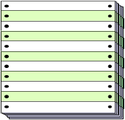

Perform Configuration Identification
4: Perform CI
What does Configuration Identification involve?
  Selection of Computer Software Configuration Items (CSCIs) and Software Units (SUs)
  Determination of the types of configuration documentation required for each CSCI
  Issuance of numbers and other identifiers affixed to CSCIs and to the technical documentation that defines the CSCI's configuration, including internal and external interfaces
  Release of CSCIs and their associated configuration documentation
  Establishment of configuration baselines for CSCIs
Notes:
Project SCM activity begins with the performing of configuration identification. Here are the tasks involved, which we’ll now discuss in a little more detail.

Slide 24

Configuration Identification (1 of 6)
4: Perform CI
Selecting Project CSCIs and SUs:
  Responsibility of project management
    Based on System Hierarchy
    Identify documentation for CSCIs
  Participation of SCM in CSCI selection desirable
    SCM provides inputs to ensure unique identifiers are assigned (e.g., apply file naming standards, etc.)
  Identified CSCIs placed under CM according to project SCMP
Notes:
In the overview of SCM, we talked about understanding the hierarchical structure of your product, and devising naming conventions that address the functionality of your product. Make sure that everything is identified, and accountable, in your SCM tracking data base.

Slide 25

Configuration Identification (2 of 6)
4: Perform CI
What types of configuration documentation are required for each CI (System), Program/Project, CSCI?:
  CI System Design
  System/Segment Design Document (SSDD)
  Interface Design Document (IDD)
  Database Design Description (DBDD)
  Program/Project Planning
  Computer Resources Life Cycle Management Plan (CRLCMP)
  Software Development Plan (SDP)
  Software Test Plan (STP)
  Software Installation Plan (SIP)
  Software Configuration Management Plan (SCMP)
  Software Quality Assurance Plan (SQAP)
Notes:
Make sure that all your system-related components are identified and controlled. Program/Project planning documents are also identified and kept under CM

Slide 26
Configuration Identification (3 of 6)
4: Perform CI
What other types of configuration documentation are required for each CI (System), Program/Project, CSCI? :
  CSCI Requirements
  Software Requirements Specification (SRS)
  Interface Requirements Specification (IRS)
  Software Design Description (SDD)
  Interface Design Document (IDD)
  Data Base Design Document (DBDD)
  Software Test Description (STD)
  Software Test Report (STR)
  Software Version Description (SVD)
  Software User Manual (SUM)
  Software Input/Output Manual (SIOM)
  Software Center Operator Manual (SCOM)
  Computer Operator Manual (COM)
  Software Product Specification (SPS)
Notes:
All documentation used to support the engineering of the software should be included in this list.

Slide 27
Configuration Identification (4 of 6)
4: Perform CI
MK50-SDD-S-RA-C0
Issuance of numbers and other identifiers affixed to CSCIs and to the technical documentation that defines the CSCI's configuration, including internal and external interfaces :
  Limit number of characters in identifiers to a maximum of 15
  Assign identifiers to CSCIs and component parts and associated configuration documentation including:
    Revision and version numbers where appropriate
    Serial and lot numbers to establish effectivity
  Ensure marking and labeling enables correlation between item, configuration documentation, and associated data
  Ensure identifiers are embedded in source and object code and where contractually specified, electronically embedded in firmware.
COMPASS-SW-SOM-3.1.0
A7600-TAC13TP01
MK50-SRS-S-R0-C0
Notes:
Here are some guidelines for generating a configuration nomenclature for your CI’s, CSCI’s and supporting documentation.

Slide 28
Configuration Identification (5 of 6)
4: Perform CI
Example 1: Document and Drawing Identifiers
Method:
SCM assigns unique identifier based on predefined naming conventions and numbering schemes. Each document or drawing page shows identification number and applicable revision number.
Examples:
“A7600-TAC13TP01”
A76 = CSCI Designator
00 = Revision Identifier (baseline version)
TAC13 = SU Designator by module acronym and serial number
TP = Document Type (Test Plan) or Drawing (DR)
01 = Volume Number (used only if multiple volumes)
“COMPASS-ICD-3.1A Ch Pg XX”
COMPASS = CSCI Designator
ICD = Document Type, or Drawing (DWG)
3.1A = Associated Version/Revision/Patch Identifier (3-1-A)
Ch Pg XX = Change Page Identifier
Notes:
Here are some examples.
Notices that each is different, yet relevant to the project – if it provides sufficient breakdown of your product’s functionality, which can assist with problem source identification and change control, then it’s enough. Don’t go overboard, but don’t be too generic.

Slide 29
Configuration Identification (6 of 6)
4: Perform CI
Example 2: Software Identifiers
Method:
SCM identifies each CSCI and all project-developed support software required for development and maintenance with unique names, numbers, and version identifiers.
Examples:
“A76B4.01-TAC.ET”
A76 = CSCI Designator
B4 = Build Number
01 = Version of working build
TAC = SU Designator by module acronym
ET = Subordinate SU designator by function (where appropriate)
“COMPASS-SW-SOM-3.1.0”
COMPASS = CSCI Designator
SW = Software (SW) or Firmware (FW)
SOM = Software module Identifier (Scenario Operation Monitor)
3.1.0 = Version/Revision/Patch
KEY: USE THE APPROPRIATE NOMENTCLATURE AND BE CONSISTENT!
Notes:
Consistency is important! Are the identifiers for software and supporting documentation consistent with each other? If not, might the wrong version of support documentation be used to support fielded software? (User calls me to report a “missing screen”, only to find that their User Manual is outdated, and doesn’t reflect the replacement of the “missing screen” with a new screen, as reflected in the current software version)

Slide 30
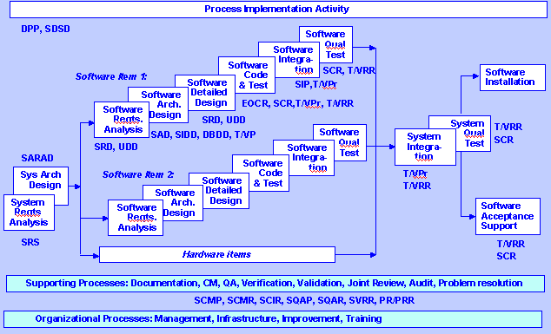
Configuration Identification – When to Do It
4: Perform CI
Release of CSCIs & associated configuration documentation (12207)
Notes:
Throughout the life of your project you will create and update software and the supporting documentation that promotes its proper use. SCM needs to be aware of the project schedules for these developments, and use this information to plan on capturing new and updated baselines for configuration management

Slide 31
Establish Configuration Baselines to CSCIs
4: Perform CI
Configuration Baselines are established based on the project’s software development strategy
Configuration baselines include (in order of appearance):
    Functional Baseline: Documentation describing a system’s or items functional, interoperability and interface characteristics and the verification used to demonstrate their achievement
    Allocated Baseline: Documentation describing an item’s functional, interoperability and interface characteristics, allocated from a higher-level configuration item
    Product Baseline: Documentation describing all of the necessary functional and physical characteristics of the CI and the selected Functional and Physical characteristics designated for product acceptance testing and support
Configuration software technical documentation, code, and media are formally designated and fixed at a specific time during a CSCIs life cycle
Configuration baseline plus approved changes to that baseline constitute the current approved configuration identification
Notes:
As changes are approved incorporated, it will become necessary to re-identify the approved changed configuration. This makes the new version severable and maintainable apart from the “old” version.

Slide 32
Perform Configuration Control
5: Perform CC
A - Receive CSCI and technical data and place them in the libraries
  Document/Drawing Library, Software Development Library
B - Process CSCI and technical data requests
C - Establish a Configuration Control Board (CCB)
  Support Change Control Process and provide Change Requests (CRs) to board members for evaluation
D - Establish a Baseline Change Process
  Document Chg. Requests, CCB Review/Accept/Prioritize, Record Disposition, support creation of new/revised Baseline
E - Identify change control documents and document procedures for creating and processing them
  Identify form, document process(es) to generate and distribute/approve
F - Report any deficiencies against this activity or suggested enhancements

Slide 33
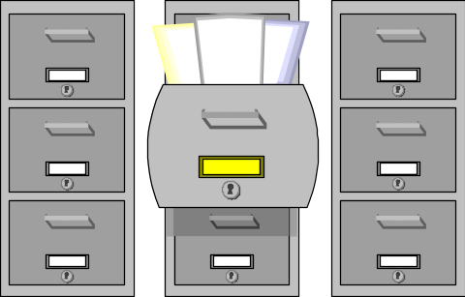
Configuration Control (1 of 12)
5: Perform CC
A - Receive CSCI and technical data and place them in the libraries
  - CM Libraries are established to control documentation and create repositories containing CSCIs and SUs
  - Typically consist of three libraries:
    Software Development Library (SDL)
    Document Library
    Drawing Library
  - The SDL comprises the controlled collection of documentation, intermediate software development products, associated tools, and procedures that comprise the Developmental Configuration CSCI
  - The Document Library contains the hard copy and soft copy of approved baseline configuration documents (non-CSCI), deliverable/non-deliverable documents, and reference materials
  - The Drawing Library comprises all project drawings (engineering, facility floorplans, design architecture, etc.)

Slide 34
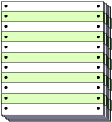
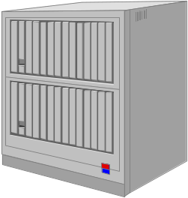
Configuration Control (2 of 12)
5: Perform CC
B - Process CSCI and technical data requests
  - Establish procedures for the controlled request and release of CSCIs, associated documentation, and other project-related artifacts
  - Procedures will include maintaining “check-in/check-out” logs, reporting status of segments/modules/documents that are in development or change process and who is developing the changes
  - If feasible, give strong consideration to the use of automated tools for assisting with controlling software/document access and overall configuration control (example: ClearCase, Merant Dimension, etc.)
BASELINE LIBRARY

Slide 35
Configuration Control (3 of 12)
5: Perform CC
C - Establish a Configuration Control Board (CCB)
  - The CCB provides formally controlled changes to delivered product baseline documentation and software and for developmental products through performance of the following functions:
    Authorize establishment of software baselines and identification of CSCIs
    Represent interests of project management and all groups affected by software changes to the baseline
    Assign, review, and provide for disposition of action items
    Provide required staff coordination on all proposed or reviewed changes or modifications
    Serve as a source for the coordination of software technical expertise for the project.

Slide 36
Configuration Control (4 of 12)
5: Perform CC
C - Establish a Configuration Control Board (CCB) (cont’d)
    Identify resources required for implementation of proposed changes
      assess impact of proposed changes upon the system
      determine cost of proposed changes
      determine impact of changes on development and test schedules
    Monitor design, production, and validation process for approved modifications; initiate corrective action process to ensure design compatibility and integrity, cost-effectiveness, and conformance to scheduled milestones.
    Direct implementation of changes approved by the SCCB (the Local Software CCB - probably YOUR CCB)
Notes:
The CCB will review and approve ALL proposed changes to the system. Meetings of the CCB are scheduled based upon the volume and severity of proposed changes – sometimes an “emergency CCB” will meet at virtually a moment’s notice to address either high-priority changes or to assess the approval of a critical requirements change or problem report.

Slide 37

Configuration Control (5 of 12)
5: Perform CC
C - Establish a Configuration Control Board (CCB) (cont’d)
    Exercise interface management support and control for project software.
    Exercise approval authority (project-level)
      Recommend approval for Class I changes
      Approve Class II changes
Class I changes affect: operational characteristics, performance, weight, interfaces, or other technical requirements in the specification
Class II changes have no operational effects; and are transparent to the user
Notes:
Class I and II defined in MIL-STD-973 – notice that Class I changes affect the existing product specifications, such that if the change were approved, the specifications would have to be modified to reflect the change.

Slide 38
Configuration Control (6 of 12)
5: Perform CC
C - Establish a Configuration Control Board (CCB) - (cont’d)
  - “Layered” CCBs will be required to ensure coordinated CM of multiple integrated systems
Program Level CCB
Example: AN/SQQ-89 ASW Suite
System CCB
System CCB
System CCB
Fire Control UFCS Mk 116
Sensors
ASW Weapons
Local CCBs:
Software (SCCB),
Hardware (HCCB)
Local CCBs:
Software (SCCB),
Hardware (HCCB)
Local CCBs:
Software (SCCB),
Hardware (HCCB)
Notes:
Understanding that there may be interfacing CCBs may help avoid duplicating approval processes for changes that have been directed by higher authority. This also helps to communicate the impact of changes on related projects.

Slide 39

Configuration Control (7 of 12)
5: Perform CC
C - Establish a Configuration Control Board (CCB) - (cont’d)
  - CCBs may interface with other technical control boards as appropriate:
    Technical Review Board (TRB)
    Operational Advisory Group (OAG)
    Maintenance Advisory Group (MAG)
    Interface Control Working Group (ICWG)
Notes:
Identify all the groups that are impacted by changes to the system, and ensure that communications are maintained, and representation is afforded members of groups to the CCB, and that the CCB is represented at each of these group’s meetings.

Slide 40
Configuration Control (8 of 12)
5: Perform CC
D - Implement a Baseline Change Process
  - Prepare and Submit the change request
  - CCB and SCCB review (justify, evaluate and coordinate)
    Assign priorities - MIL-STD-498 provides detailed descriptions for priorities:
      Priority 1: Prevents the accomplishment of an operational or mission essential capability
      Priority 2: Mission degrade with no work-around
      Priority 3: Mission degrade with workaround
      Priority 4: Minor
      Priority 5: Other
    Classify problem/enhancement categories (affects plans, concept, requirements, design, code, database/data file, test info, manuals, other)
  - CCB and SCCB disposition (approve, disapprove, defer, etc.)
    CCB approves Class I changes
Notes:
The assignment of priorities refers primarily to system/software trouble reports, but can also be used to categorize requested changes to the system/software.

Slide 41

Configuration Control (9 of 12)
5: Perform CC
D - Implement a Baseline Change Process (cont’d)
    SCCB recommends approval of Class I changes, SCCB approves Class II changes
    CM takes minutes of CCB meetings and archives them in the project SDL
  - System/Software Engineering Implementation of the approved change to software and documentation
  - CCB and SCCB approves baseline and approves baseline release
Notes:
The SCCB typically operates as a sub-group supporting the higher-level CCB.
If the organization is small, there are no interfaces to other projects, or the scope of the system/software is fairly limited, CCB boards for software and hardware may be combined, and further combined with the overall system-level CCB.
The key is to ensure that everyone who has responsibility in the building and maintaining of the system and its related components is involved.

Slide 42
Configuration Control (10 of 12)
5: Perform CC
D - Implement a Baseline Change Process (Example) (cont’d)
Need for
change
Change Request generated
Evaluation
more info needed
ok
Change report generated
Engineering change order generated
accept
CCB
decision
reject
Place on queue for change
Requestor is informed
Other SCM
tasks
Notes:
Although highly simplified, this chart shows the typical flow of activity when generating, reviewing, approving and implementing changes.
Developing a workflow process chart may help you to pinpoint discrepancies or shortfalls in your existing process, or if starting a new process, may help you visualize a proposed process and the relationship of tasks.

Slide 43

Configuration Control (11 of 12)
5: Perform CC
E - Identify change control documents and document procedures for creating and processing them
  - Project may use some or all of the following change request forms. Refer to the Generic SCMP and MIL-STD-973
  for a description of these forms and their processing:
    Engineering Change Proposal
    Specification Change Notice
    Notice of Revision
    Deviation and Waiver
    Local Change Request

Slide 44
Perform Configuration Control (12 of 12)
5: Perform CC
F – Report any deficiencies against this activity or suggested enhancements
  SCM work with SQA to review SCM processes and products to determine whether goals and objectives for effective CM control are being met
  When appropriate document process changes to SCMP via Document Change Requests (DCRs) to recommend improvements in the SCM process; coordinate planned SCMP changes with your Department SPI to ensure consistency with organization process (suggest improvements to the organization process if appropriate!)

Slide 45

Perform Configuration Status Accounting
6: Perform CSA
  A - Establish/Maintain CSA system
  B - Receive CSCI and technical data for entry into the CSA system
  C - Generate CSA reports
  D - Report any deficiencies against this activity

Slide 46
Configuration Status Accounting (1 of 9)
6: Perform CSA
  A- Establish/Maintain CSA system
    Document a Data Base design to identify the elements that will comprise the CSA (e.g. Configuration Identifier, Description, Change Status, Location(s), Current/Archived Baseline Version(s), etc.). MIL-STD-973, Appendix H provides suggested CSA requirements and records, Appendix I provides a recommended standard set of CSA elements
    Establish MINIMUM Data Entry requirements to establish a CI record in the CSA system
    Consider acquiring an automated CSA data base tool
    Maintain control conventions for access to and update of CSA contents

Slide 47
Configuration Status Accounting (2 of 9)
6: Perform CSA
  B - Receive CSCI and technical data for entry into the CSA system
    Establish the technical data necessary to update the CSA system
  Example (Required Data Elements for a Software Trouble Report):
    Date (date format)
    Category-Software, Design, Engineering, Logic, Other (1-character field)
    Priority-1 thru 5 (1-digit numeric field)
    STR # (numeric field, Auto generation, starting with 1)
    STR title (alpha-numeric field, 55 characters max)
    Originator (20-character field)
    Activity/Code (alpha-numberic character field, 40 characters max)
    Telephone/Ext. (alpha-numeric field, 20 characters max)
    Status (table field)
  - Accomplish the initial data entry and maintain current data in the CSA system (un-maintained data quickly becomes useless!)

Slide 48

Configuration Status Accounting (3 of 9)
6: Perform CSA
  C - Generate CSA Reports. These reports should include:
    Identification of currently approved configuration documentation and configuration identifiers associated with each CSCI
    Status of proposed change requests from initiation to implementation.
    Results of configuration audits; status and disposition of discrepancies
    Traceability of changes from baseline documentation of each CSCI
    Effectivity and installation status of configuration changes to all CSCIs at all locations.

Slide 49
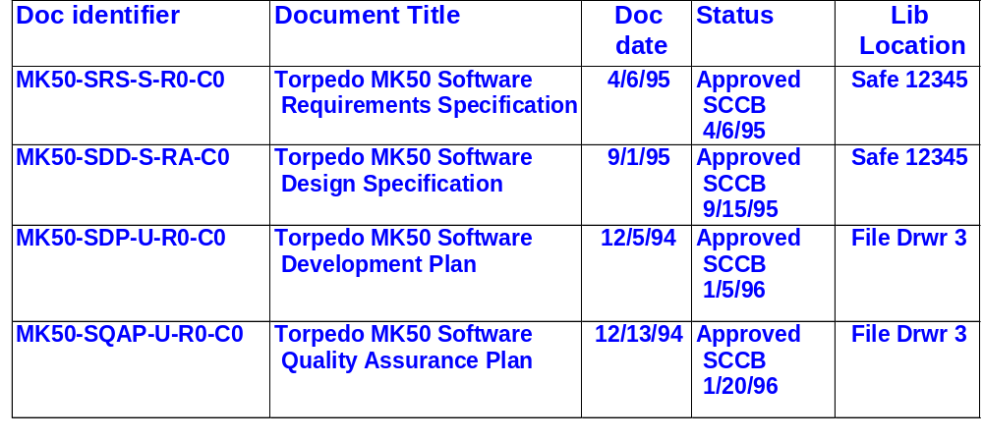
Configuration Status Accounting (4 of 9)
6: Perform CSA
  C - Generate CSA Reports. (sample reports)
  Record of Approved Configuration Documentation and ID Numbers

Slide 50
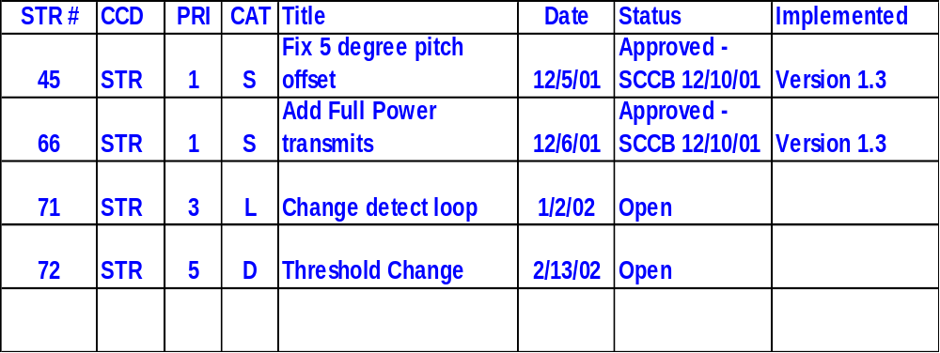
Configuration Status Accounting (5 of 9)
6: Perform CSA
  C - Generate CSA Reports. (sample reports)
Status of proposed changes, deviations, and waivers to the configuration

Slide 51
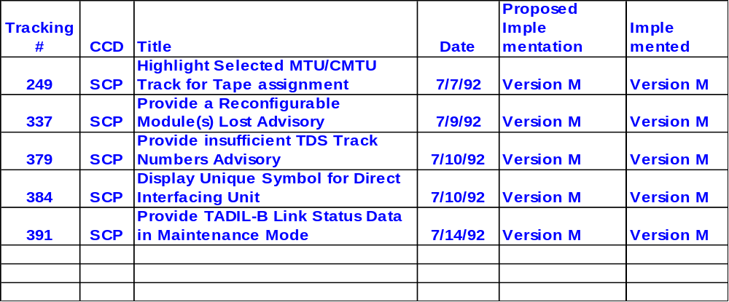
Configuration Status Accounting (6 of 9)
6: Perform CSA
  C - Generate CSA Reports. (sample reports)
  Implementation status of approved changes

Slide 52
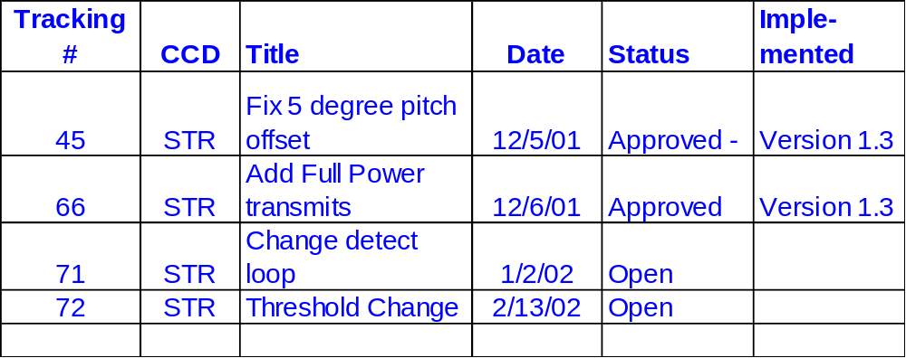
Configuration Status Accounting (7 of 9)
6: Perform CSA
  C - Generate CSA Reports. (sample reports)
  Product Baseline for Release Version 1.3

Slide 53
Configuration Status Accounting (8 of 9)
6: Perform CSA
  C - Generate CSA Reports: Field Requests for CSA Reports.
    Requests for CSA reports originating outside the project are directed for approval to Project Management which authorizes need-to-know access
    SCM should provide on a periodic basis or allow access to CSA Reports to all members of the project
    SCM maintains the CSA Report Distribution list

Slide 54
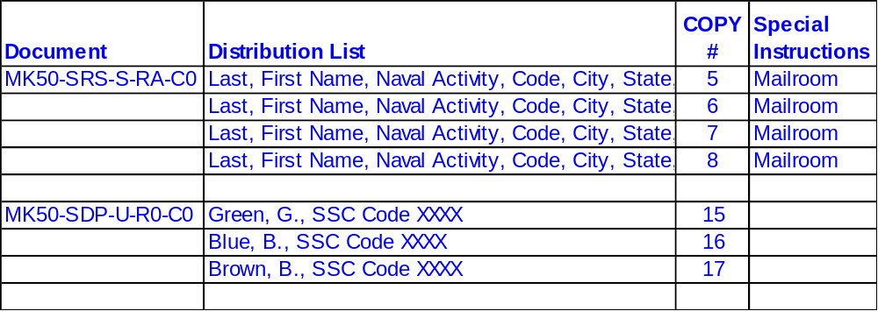
Configuration Status Accounting (9 of 9)
6: Perform CSA
  C - Generate CSA Reports: Field Requests for CSA Reports.(cont’d)
    CSA Report Distribution list (sample)

Slide 55
Perform Configuration Audits and Reviews
7: Perform audits
- Formal Audit Types
  Functional Configuration Audit (FCA)
  The formal examination of functional characteristics of a configuration item, prior to acceptance, to verify that the item has achieved the requirements specified in its functional and allocated configuration documentation. Functional Characteristics are quantitative performance parameters and design constraints, including operational and logistic parameters and their respective tolerances. Functional characteristics include all performance parameters, such as range, lethality, reliability, maintainability, and safety.
  Physical Configuration Audit (PCA)
  The formal examination of the “as built” configuration of a configuration item against its technical documentation to establish or verify the configuration item’s product baseline.
  FCAs and PCAs are described in MIL-STD-973

Slide 56

Configuration Audits and Reviews
7: Perform audits
  - CM support for configuration audits:
    Assist in the audit
    Review audit checklist
    Prepare SCM reports, logs or records required to support the audit
    Establish and maintain baseline specifications and product files
    Follow up on audit reports to assess possible SCM impact
    Provide storage for audit documentation, records and products
    Ensure audit report action items are resolved

Slide 57

Configuration Audits and Reviews
7: Perform audits
  - Required Plan documentation to conduct FCA/PCA:
    An FCA/PCA Plan is written to:
      Identify the specific tasks and procedures to accomplish these audits
      Identify the documents, hardware, software and test sets required for performing the audits and what is to be examined
    The resulting FCA/PCA Report:
      Reports the results of the audit findings
      Requires resolution of open issues or action items

Slide 58
Configuration Audits and Reviews
7: Perform audits
  - Typical Scheduling of FCA/PCA:
    FCA:
      After a major change or significant numbers of minor changes have occurred or before the establishment of the Product Baseline
    PCA:
      Concurrently with the FCA or immediately following an FCA
  NOTE: IF the project maintains effective CM control, the FCA/PCA should be a SLAM DUNK!

Slide 59
Configuration Audits and Reviews
7: Perform audits
  - Other periodic informal CM audits:
    Performed as deemed appropriate by the project manager
    SCM Audits. Independent audit of SCM processes, procedures, and products to ensure that the SCM program complies with the requirements of the SCMP
    SCM Reviews. Internal review to determine how effectively and efficiently the SCM process and procedures fulfill the SCM requirements as defined in the SCMP. Includes verification of products generated by SCM
    SQA typically conducts or assists with both formal and informal audits

Slide 60
Configuration Audits and Reviews
7: Perform audits
  - Documentation from formal and informal CM audits (SCM Deficiency Report):
    Identify noncompliance with SCM processes, procedures, and products against requirements of the SCMP
    Identify areas for improving effectiveness and efficiency in SCM processes and procedures
    Provide results of verifying products generated by SCM (e.g., status reports, change requests forms, etc.)

Slide 61

Implementing SCM: Subcontractor Support
  - Should your project’s Configuration Management function be partially or completely subcontractor supported:
    Use these same guidelines to establish subcontractor performance requirements
    Employ Government CM/SQA representation to verify compliance of subcontractor activities with SCM plans and procedures
    Document and resolve discrepancies in performance in the same manner as you would government personnel-supported SCM

Slide 62
Implementing SCM: Applying the SCM Process
Conclusion
  Sound Configuration Management is an essential element of every well-managed software project.
  Thank you for your participation in this training class!
  ANY QUESTIONS?
SCM

